Slide 1
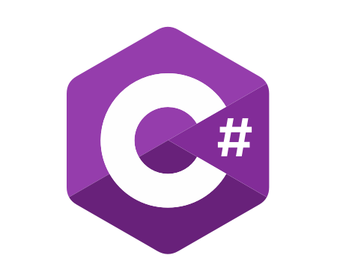
Architecture of ASP.NET Core Microservices Applications
Course Introduction
SoftUni Team
Technical Trainers
Software University
https://softuni.bg/

Slide 2
Table of Contents
Course Objectives
Training and Team
Course Organization
Course Infrastructure
Evaluation Criteria

Slide 3














SoftUni Diamond Partners

Slide 4
Have a Question?
sli.do
#microservices

Slide 5

Course Objectives

Slide 6
Why Microservices?
Modern architecture
Scalable in terms of development and resources
Microservices allow:
Distributed applications
Independent development
Independent testing
Independent deployment
Independent versioning
The pattern contains multiple challenges

Slide 7
Project Defence
This course is practical-oriented
I will create a web application
Using the microservices approach
You will create one too
Throughout the next 2 months
It will require up to 10 hours per week commitment
You will need to defend it to get a certificate
Both the project and the certificate are optional

Slide 8

The Team

Slide 9
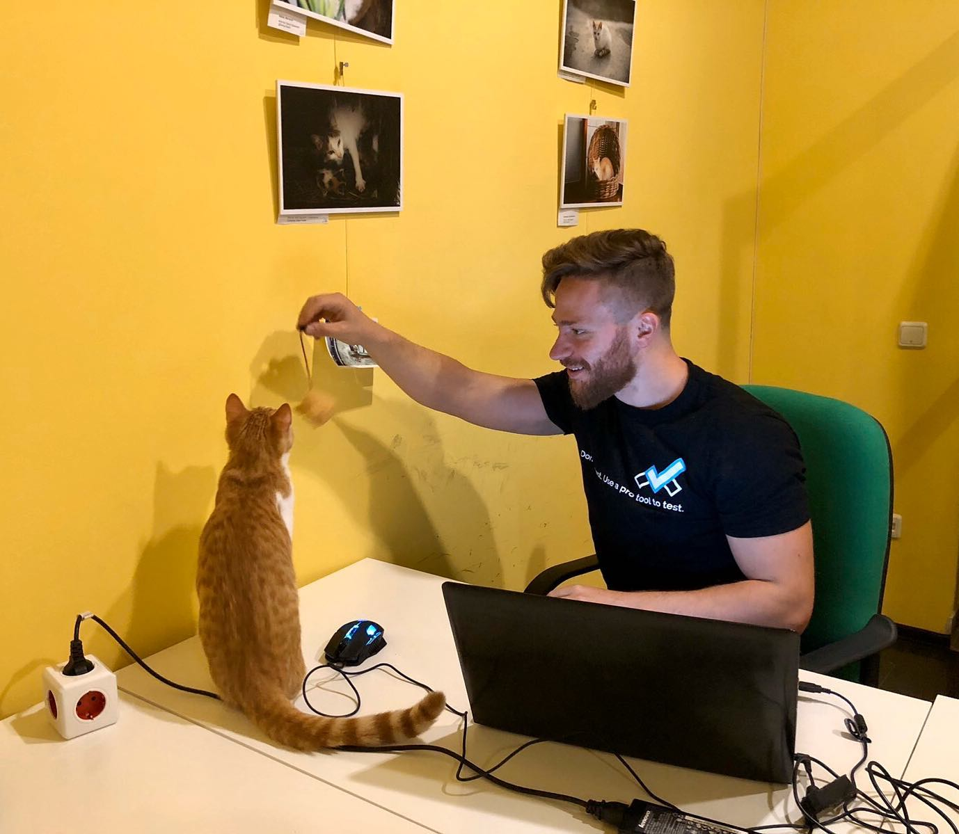
Ivaylo Kenov
Ivaylo Kenov – Quality Code Advocate
Various job titles at the same time:
Organizer & Speaker @ Code It Up
CTO @ SoftUni
Full Stack Technical Trainer @ Everywhere
Code General @ https://MyTestedASP.NET
Meme Copy Machine @ Daily Programming Fun
{Insert Job Title Here}
Contacts
https://github.com/ivaylokenov
https://facebook.com/ivaylo.kenov
https://linkedin.com/in/kenov
https://www.instagram.com/ivaylokenov/
YouTube
https://youtube.com/MyTestedASPNETTV

Slide 10

Course Organization

Slide 11
Architecture of ASP.NET Core Microservices Applications – Timeline
5-June-2020
18-July-2020
25-July-2020
Architecture of ASP.NET Core
Microservices Applications
6 weeks * 1 time / week
12 credits
Start: 5-June-2020
Project Defence: 18-July-2020
Project Defence Retake: 25-July-2020

Slide 12

Homework Assignments & Exercises
Your homework is the project you need to defend
Lesson days → slides + live demos + requirement
How to submit your homework?
Submitted in course instance page
Provide a GitHub repository
Do your homework when it's due
Assignments pile up quickly

Slide 13



Course Web Site, Forum and FB Group
Official web site:
Official discussion forum:
Official Facebook group:
Community Facebook group:
https://softuni.bg/trainings/2999/architecture-of-asp-dot-net-core-microservices-applications-june-2020
https://softuni.bg/forum
https://www.facebook.com/groups/ArchitectureofASPNETCoreMicroservicesApplications/
https://www.facebook.com/SoftUniCSharpCommunity/

Slide 14
Questions?
Notes:
14

Slide 15
Trainings @ Software University (SoftUni)
Software University – High-Quality Education, Profession and Job for Software Developers
softuni.bg, about.softuni.bg
Software University Foundation
softuni.foundation
Software University @ Facebook
facebook.com/SoftwareUniversity
Software University Forums
forum.softuni.bg
15
Notes:
15

Slide 16

License
This course (slides, examples, demos, exercises, homework, documents, videos and other assets) is copyrighted content
Unauthorized copy, reproduction or use is illegal
© SoftUni – https://about.softuni.bg
© Software University – https://softuni.bg
Notes:
16

